Slide 1


Slide 2
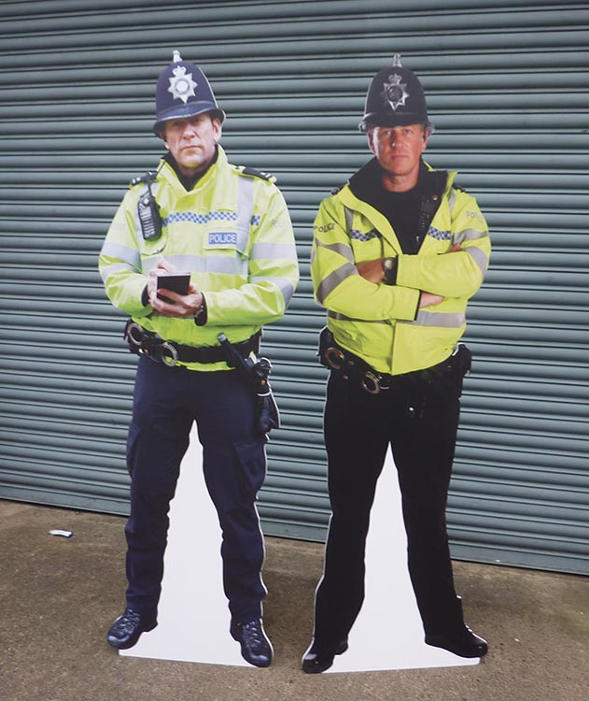

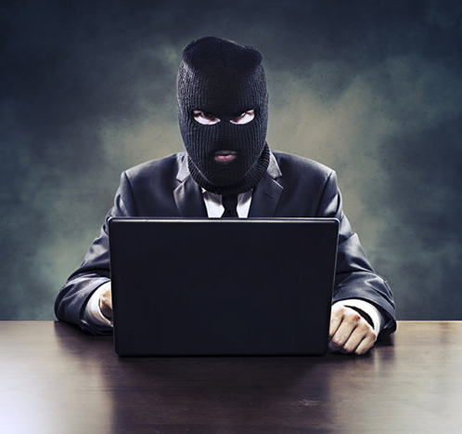

Disclaimer
Don’t do illegal shit

Slide 3
Physical Security
Contents:
What is Physical Security
Building Access (Securing a Building)
Security Layers
Bypassing Security (Educational)
Public Keys
Lock Picking
People
Jobs in Physical Security
Read Teaming
References

Slide 4
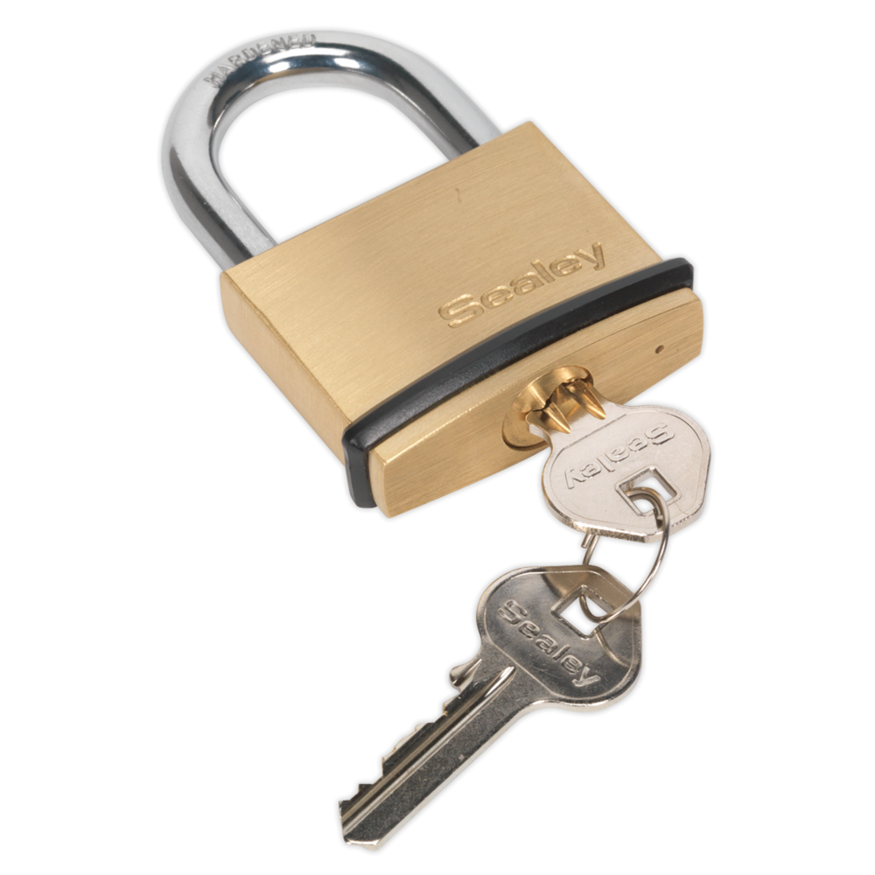
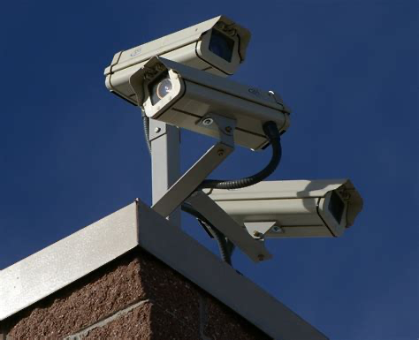
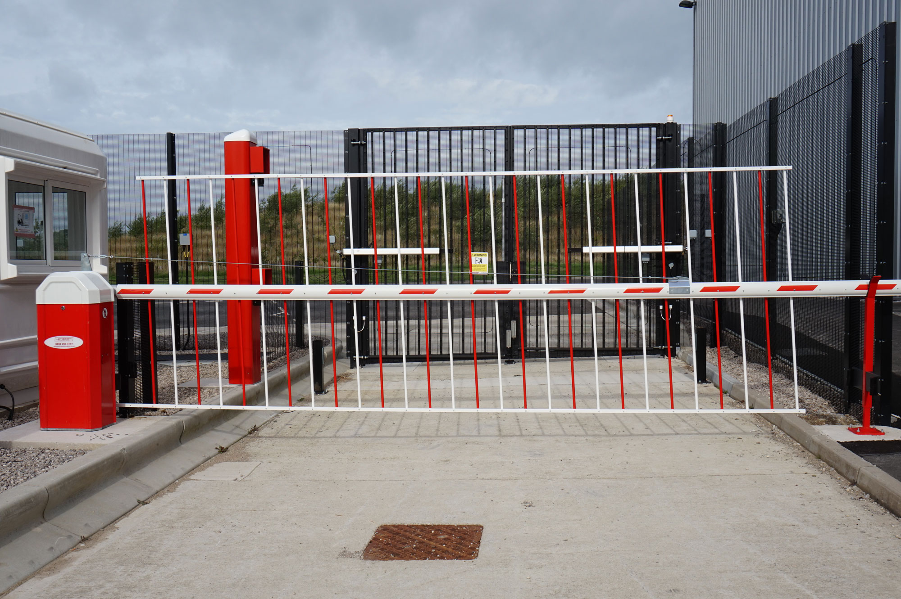
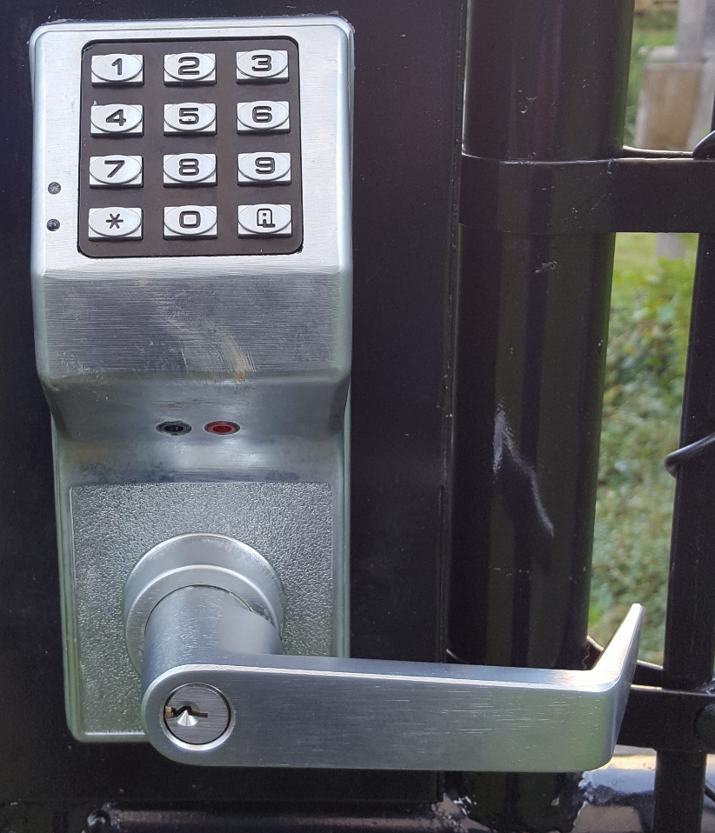
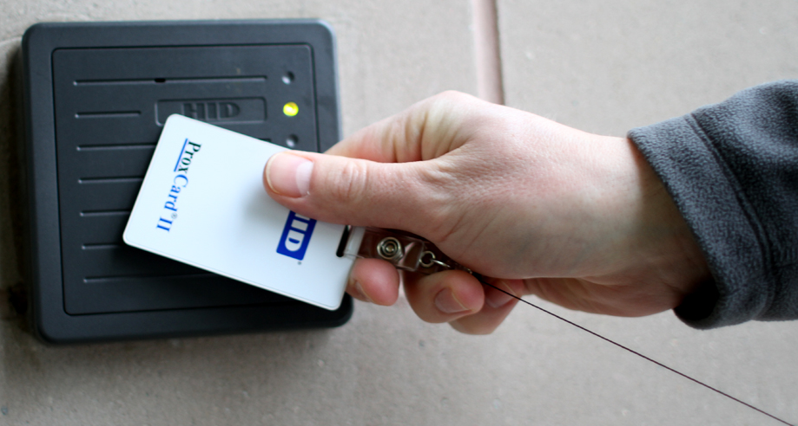
What is Physical Security
Task of protecting assets from compromise/harm.
Notes:
What is physical security? Well as it says on the powerpoint physical security is the ‘task of protecting assets from compromise/harm’. Assets meaning what?
People
Information
Hardware
Software
And the methods used to keep such things safe vary from simple door locks to giant gates with security cameras on every corner. It all depends on how valuable things are deemed.
We all have examples of physical security on us right now as most of us (hopefully all of us) used our university provided ID cards to enter this room. While it may seem like a small thing it is one of many different ways that help keep things secure.

Slide 5
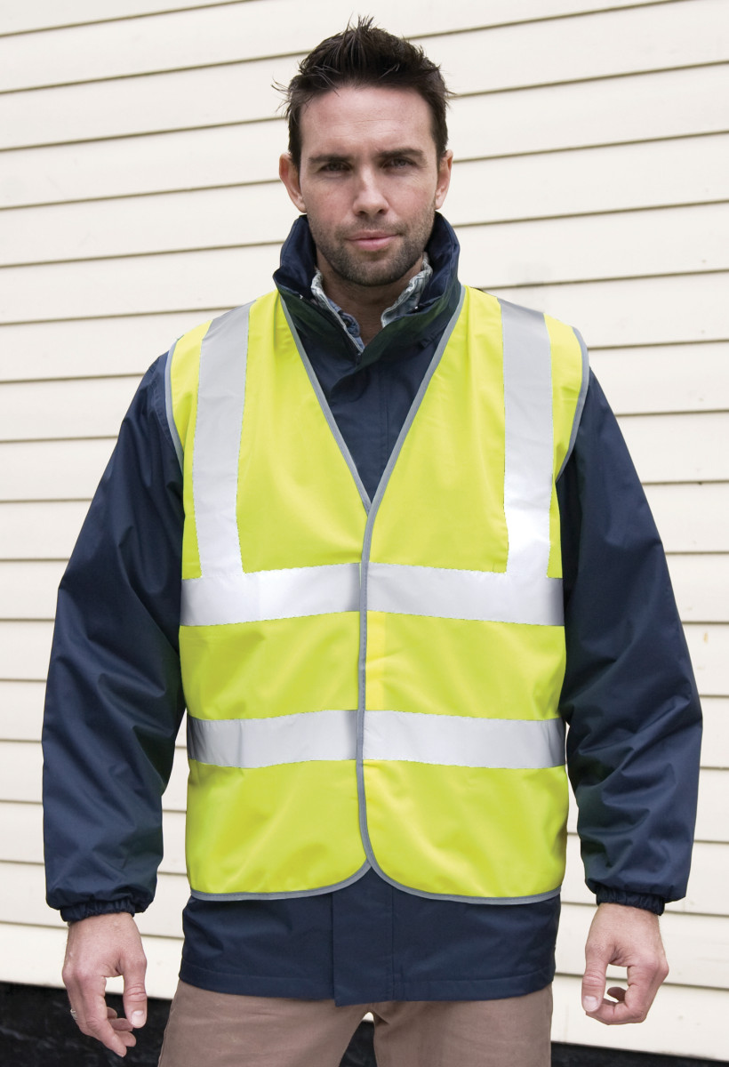
Building Access
Security measures:
Access control
Surveillance
Intrusion detection
Security personnel
Notes:
When it comes to making sure that a building is secure there are many different steps that you can take. As you will have seen of the previous slide there is a myriad of ways that you can “secure” somewhere but one thing you need to make sure is that the security doesn’t get in the way of people doing their jobs.
What do you think the best security measure for a building to have is? (Audience Question)
Planning what security measures you will have is a big part for this, if you do not plan out how each level of security will come together then it is very likely that things will not go the way that you want them. Key things to consider when planning physical security:
Areas that have an entrance secured should have all entrances to and from that area also secured
Cameras should cover an entire area not just a section
Check points should be placed at regular intervals (such as card scan points)
People should not be afraid to question others that work in the environment (more on this later)
Types of security measures to consider:
Access control
Surveillance
Intrusion detection
Security personnel

Slide 6
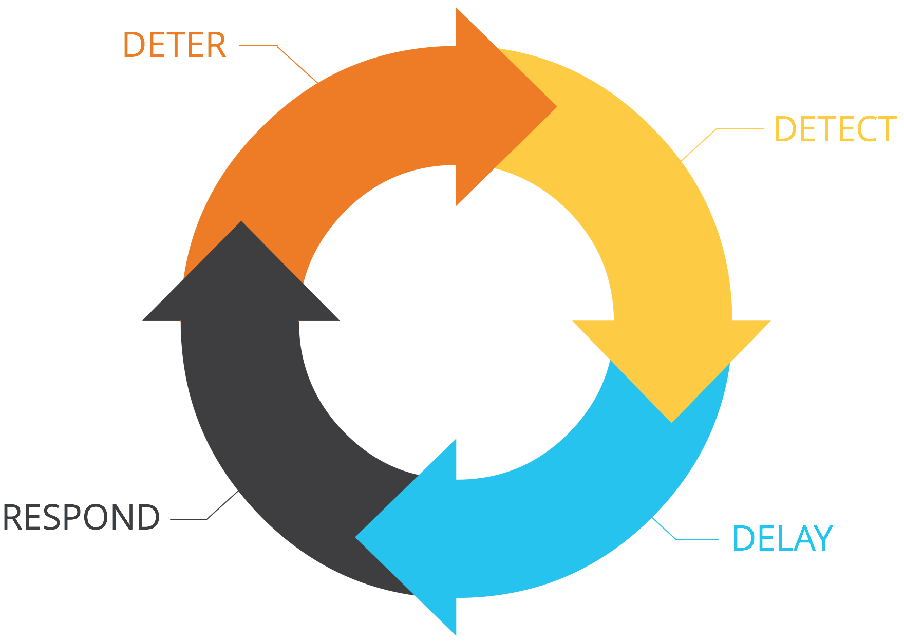
Deter
Detect
Delay
Respond/Recover
Notes:
Deter
Implement measures that stop people from attacking before they even try. Examples of this are just including security in the first place, it is often the case that when low level attackers see something like security guards or CCTV cameras they will think again about attacking the establishment. There are more advanced things you can do but the very basics of deterring people is just having some security that people can see.
Detect
Making sure that you are monitoring the different security measures that you have put in place so that if something does happen then you are aware of it immediately. Good example of this would be having a security team watching any cameras on site for people who should not be there, making sure that any logs produced by doors are also accessible by security so they can see if there is anything abnormal.
Delay
This is where having other security measures in place comes into play. If security sees someone on the camera they need time to get someone over there to talk with the person. Having doors that are secured using key cards would slow them down because if they do not have access they need to ask someone else to get the door for them.
Respond/Recover
This is the last stage of the process. Here is how you act with the information you have gathered. As you will see in the image it is often called respond but it is also known as recover depending what type of attack took place. In the case of physical security it will most of the time just be someone responding to what has occurred.
Just something I want to add quickly is that this does not cover security theatre. Which is where something looks like it is making the place more secure but often has not real effect on how secure the place is. A good example of this is the TSA, research has shown that the TSA does not really do anything to stop terrorist attacks. There are links within the references tab if you are interested in learning more about this.

Slide 7
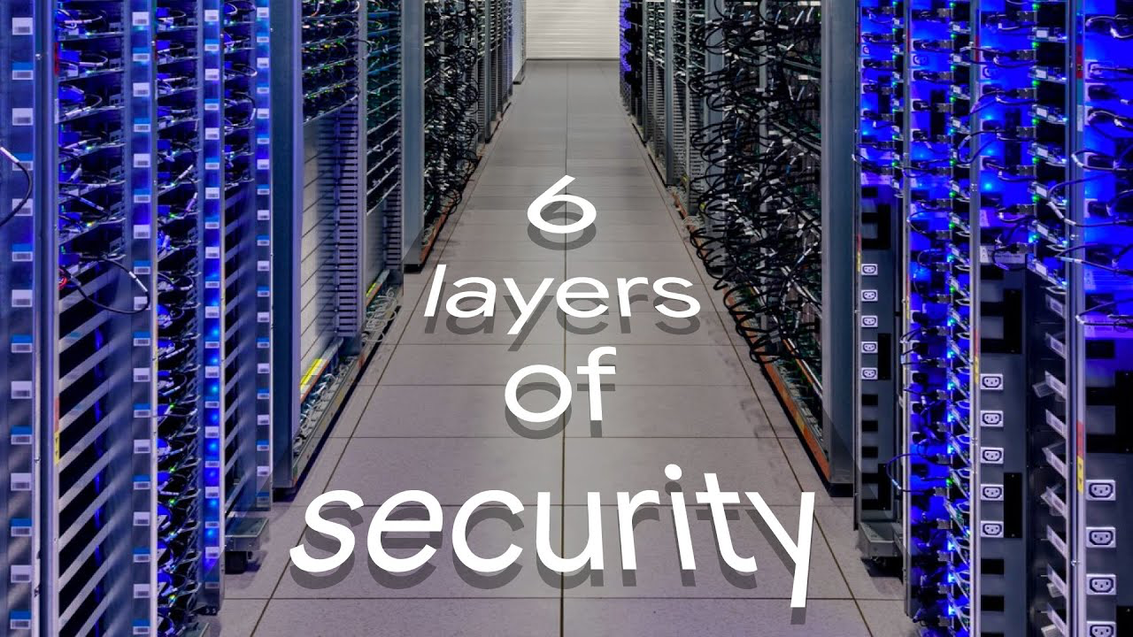
Security Layers
Google’s 6 Layer Security System
Property boundaries
Smart fencing, patrol guards, CCTV & crash barriers
ID cards & iris scanners
Monitoring
Need access only
Two way lock door
https://youtu.be/kd33UVZhnAA
Notes:
Layer 6 - lock box two way door
While looking into physical security I came across Google’s data centre security levels and while the video is a good watch if you have the time, it is too long to show in the session so here is just a quick summary. There are 6 total layers in the system.
Layer 1 is the property boundaries itself.
Layer 2 is made up of smart fencing (fencing is made up of fibre that apparently allows Google to know whether someone is near or touching the fence based on heat), guards on foot & driving around campus, cameras that are thermal, night vision & normal cameras. And for when car try to get access to the campus without authorisation there are crash barriers to stop the car in its tracks.
Layer 3 is building access using both ID cards are iris scanners to make sure that the person using the ID is in fact the right person.
Layer 4 is the security operations centre (SOC) where all the different security layers of security are monitored. They look at all the information that is being gathered and if something is deemed an anomaly or is wrong then a member of the security team is tasked to investigate what is going on.
Layer 5 is a need only access area, it is the data centre floor. There are so few people that have access to this level that is someone is there that shouldn’t be it is known right away and sorted out by security.
Layer 6 final layer so security is where drives go to die. Even fewer people have access to this level within Google data centres, it is known at all times who is within this area and what they are doing. Drives are entered into a 2 way lockers system that once locked on one side can only be accessed by the other.

Slide 8
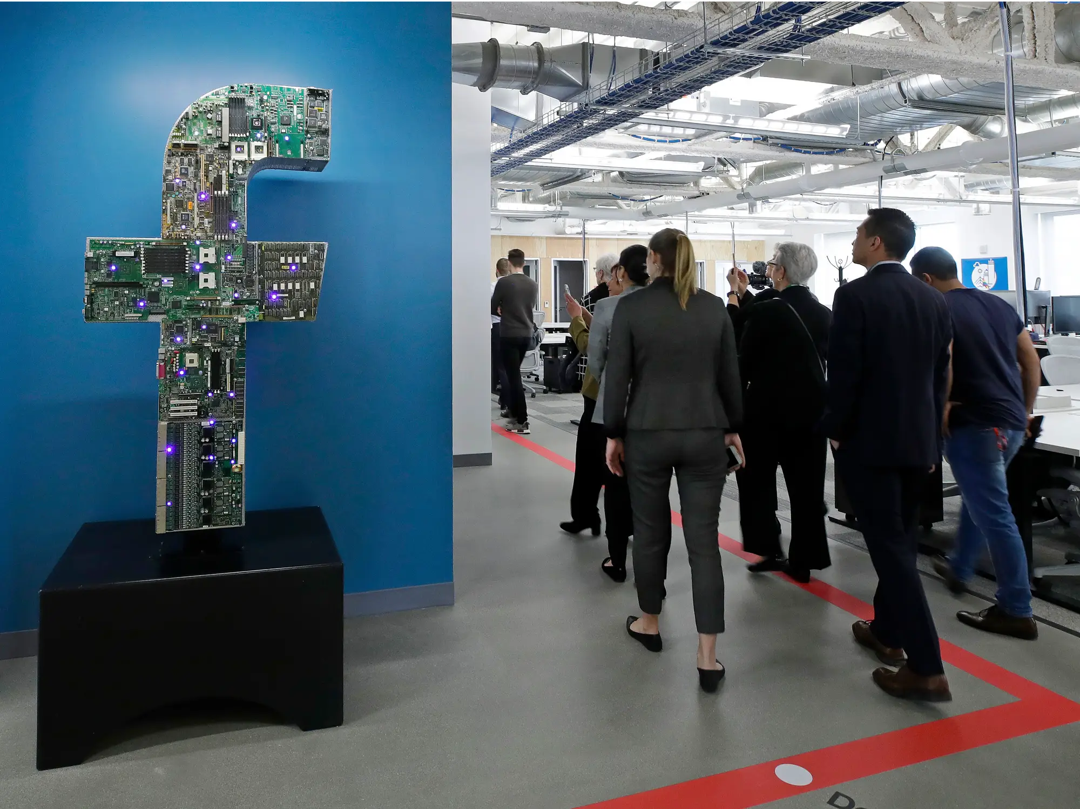
Building Access Fail
Facebook employees are unable to access building due to DNS fail.
Notes:
Facebook employees get locked out of their office buildings due to DNS fail.
Does anyone have any other examples of times when building access has failed?

Slide 9
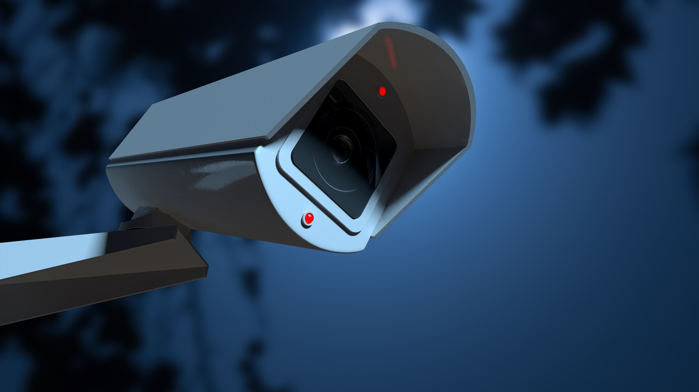
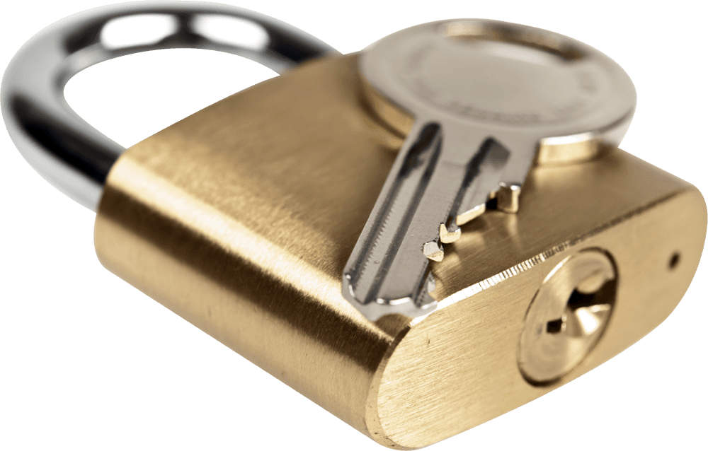
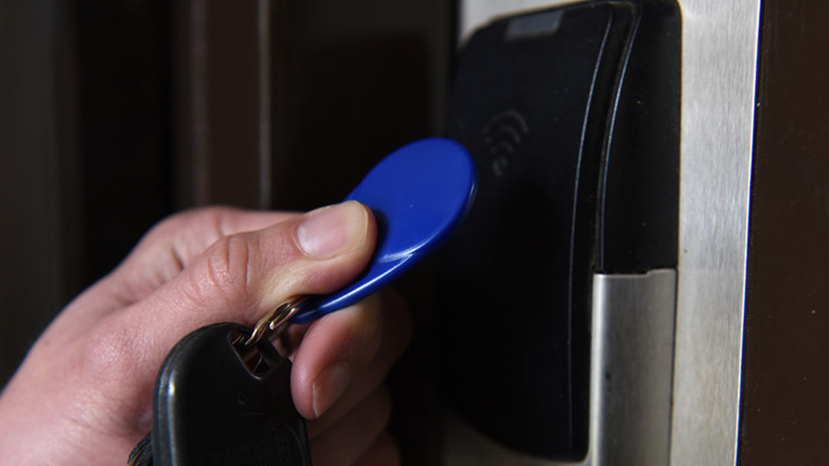
Bypassing Security (Educational)
Don’t do illegal shit!
Notes:
Now as this is an ethical hacking society I am going to talk about ways in which you can get past the different security mechanisms that we have just talked about. Please remember “Don’t do illegal shit”, this is for educational purposes only and if you are to attempt this please have the permissions of the boss/owner or whoever is the most senior person. Also make sure that even with permission you have it printed out with you while you are undergoing the task.

Slide 10
Public Keys
Best security is obscurity!
Notes:
I don’t know about you guys but often when I see the words public keys I think about things like SSH keys and encryption keys but in this case what I am actually referring to are common keys that are used within the public domain. Often times these are on a lot of different items but because they are not things that you interact with on a daily basis or things that you even have to think about you don’t really notice them.
Over the course of the next few slides I am going to show you a series of different keyholes that are all over the place while you are out and about. The bad thing about these locks is that getting the keys for them are extremely easy and are not even that expensive to buy.

Slide 11
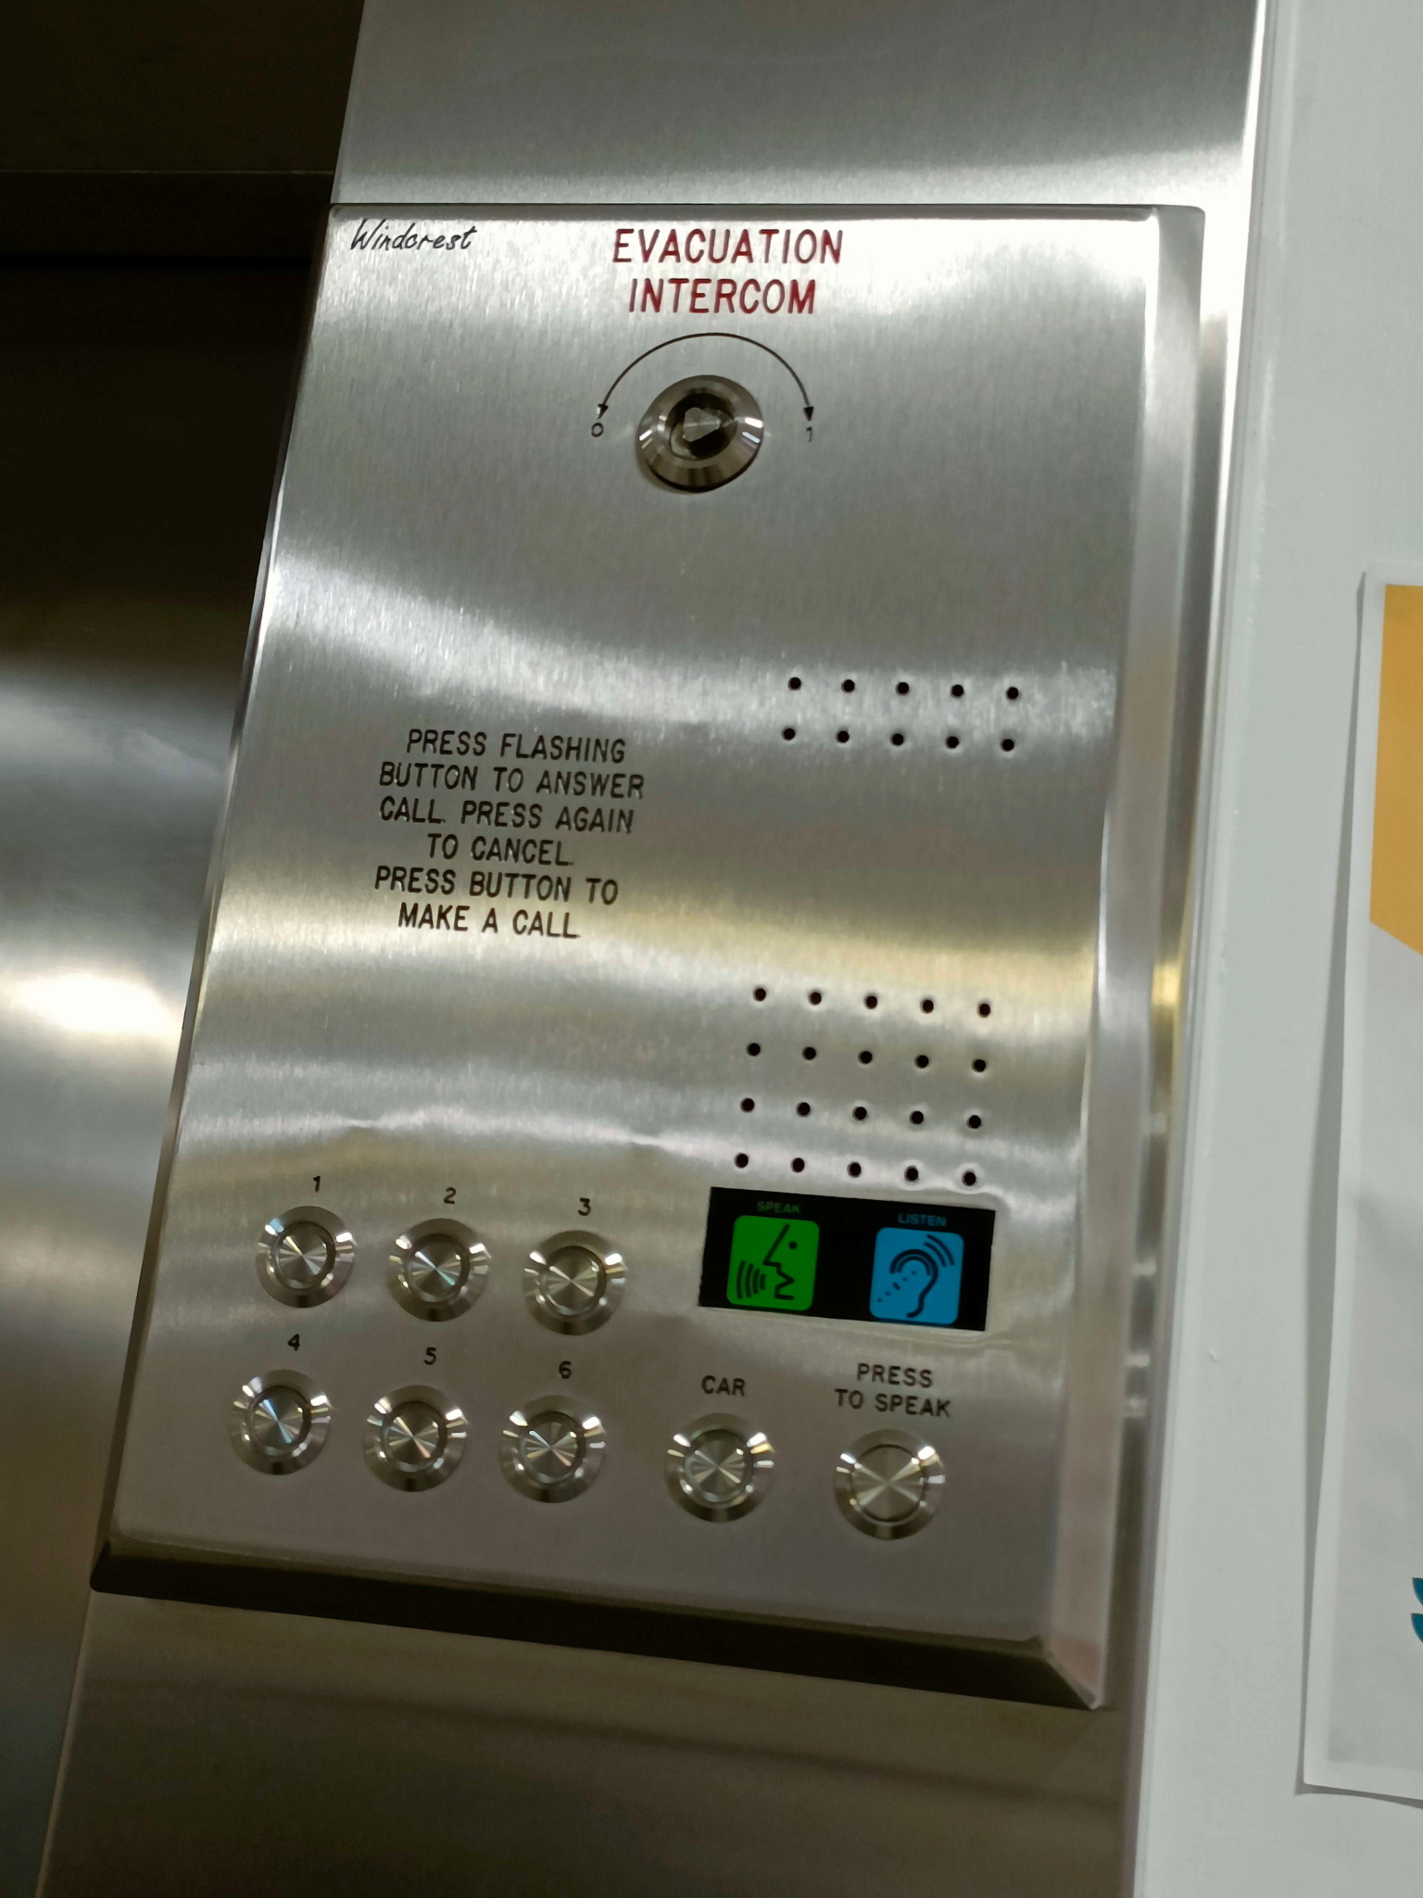
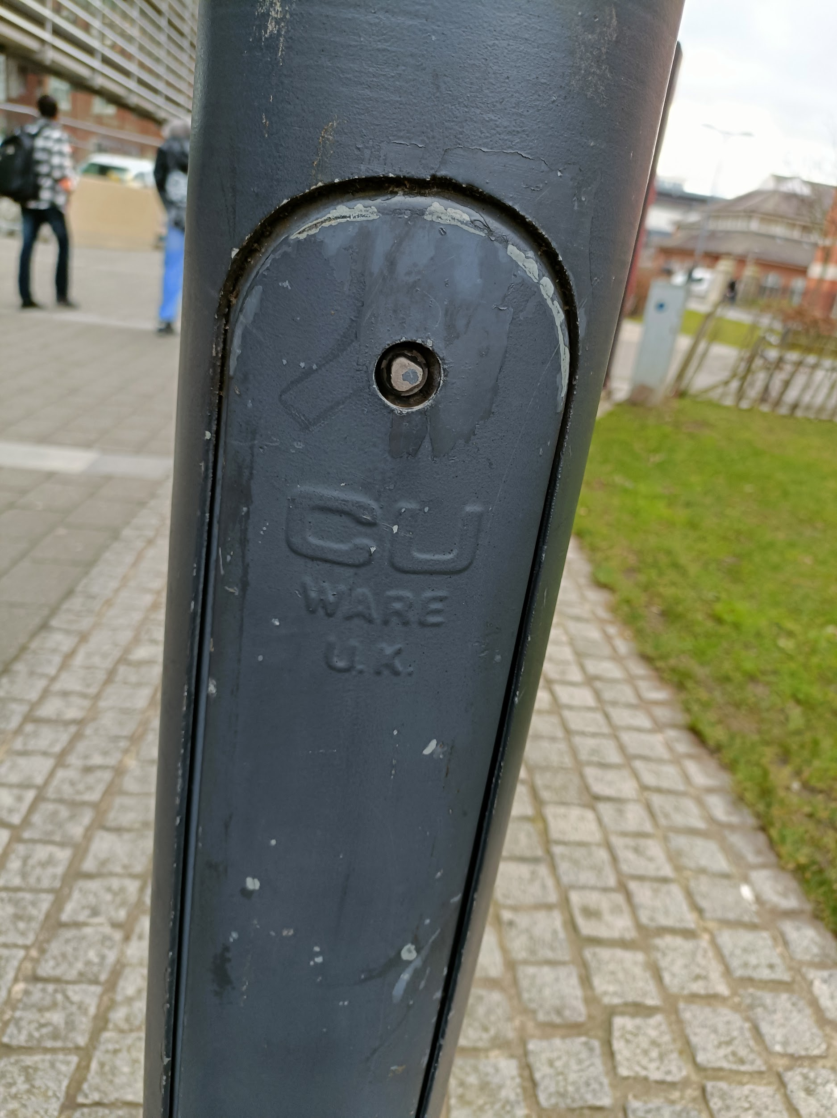
Notes:
Looking at the image some of you might know where this is.

Slide 12
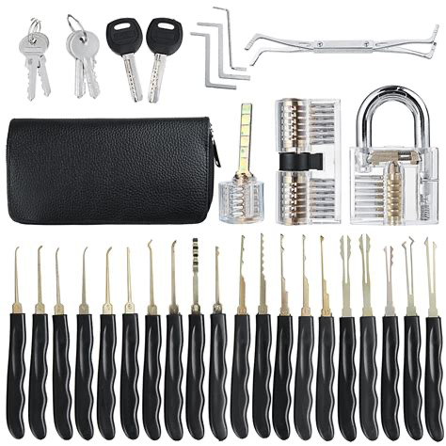
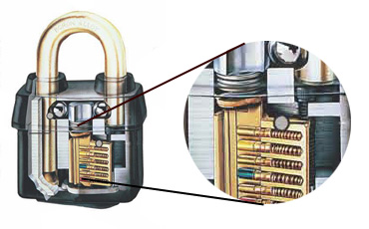
Lock Picking
Lock picking lawyer
https://www.youtube.com/@lockpickinglawyer
Notes:
When it comes to locks there are some well known tools that you can get in order to help you. As DMU Hackers we actually own some locks and some lock picking sets that you can have a little bit of a go with. But a lot of locks are based on a prongs that the key moves in a certain order as it is placed into the slot. What these lock picking sets allow you to do is use this knowledge to your advantage, so long as the hit the prongs you can unlock the lock. Some people are so efficient with theses sets that it wouldn’t surprise me if they could get into anywhere.
A good example of someone who is good at picking locks is Lock Picking Lawyer who if you are interested in I would recommend you take a look at their YouTube channel.

Slide 13
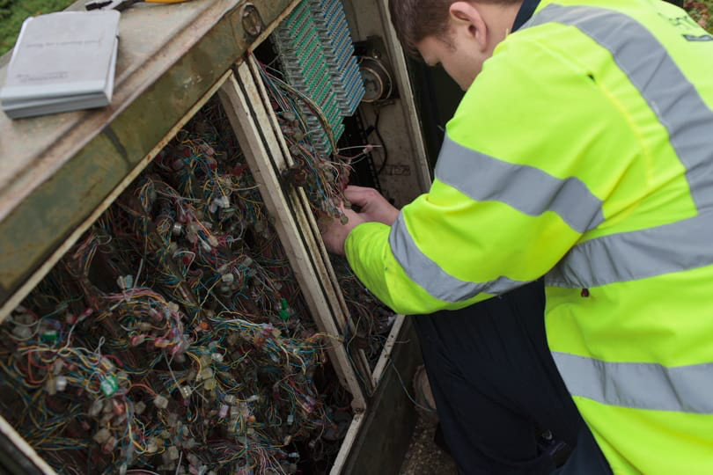
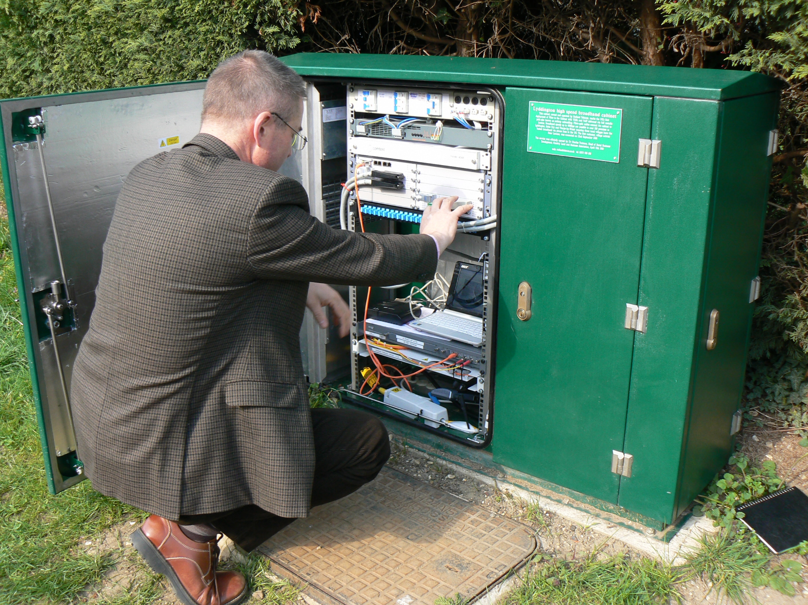
People
Notes:
This is the easiest way out of all the different ones that I have listed so far, or at least I feel that way. The problem with people, especially people in the UK, is that we are not ones for confrontation meaning that a lot of the time we just leave people to their own stuff without getting in the way. Knowing this can be used to your advantage, especially if you dress the part.
Just a quick question out of everyone here who scanned their university ID on all the doors as they came in? Who let someone follow in behind them after they had badged in the door?
Everyone in this room looks like a university student so as you are playing the part it is more likely that people are going to let you in. Another good example would be carrying a stack of books with a coffee mug on top. Someone is more likely to hold open the door for you and let you in as they see that you don’t have hands free, in that moment it doesn’t even occur to the other person that you might not have access to that given area.
Understanding the little bits about people act and behave can play to your aid if you know it well enough, being able to use this to your advantage can often allow you to get into places that you aren’t supposed to be just because you look like you are supposed to be there.
Out of the two images on the screen who looks like they should be there more?

Slide 14
Jobs in Physical Security
Red Teaming

Slide 15
References
https://www.techtarget.com/searchsecurity/definition/physical-security
https://www.protectivesecurity.govt.nz/physical-security/lifecycle/design/apply-good-practices/deter-detect-delay-respond-recover/
https://www.openpath.com/physical-security-guide
https://safetyculture.com/topics/building-security/
https://futurism.com/the-byte/facebook-employees-have-reportedly-been-locked-out
https://en.wikipedia.org/wiki/Security_theater
https://www.csoonline.com/article/3544293/5-examples-of-security-theater-and-how-to-spot-them.html
https://youtu.be/QKEdKdgi2hg
https://libertarianinstitute.org/articles/tsa-airport-security-theater-guide/
https://youtu.be/kd33UVZhnAA
https://www.businessinsider.com/facebook-employees-no-access-conference-rooms-because-of-outage-2021-10?op=1&r=US&IR=T
https://thepostmillennial.com/facebook-outage-ongoing-as-company-scrambles-to-bring-services-back-online

